Slide 1
Uber
Ride Dashboard Analysis
Data Analytics Portfolio Project
Microsoft Power BI | Data Analysis | Interactive Dashboard
Portfolio Project by: Rajat Bareja
Role: Data Analyst
Tools: Power BI, SQL, DAX, Excel
GitHub: github.com/RajatBareja

Slide 2
Uber
Table of Contents
Project overview — what this presentation covers
01
Project Overview
06
Data Modeling
Objectives, scope, and tools used
Relationships and schema design
02
Problem Statement
07
KPIs & Metrics
What challenges this project solves
Key performance indicators defined
03
Dataset Description
08
Dashboard Pages
1.5L+ ride records across 19 columns
Home, Overview, Vehicle, Revenue, Rider, Location
04
Tools & Technologies
09
Results & Insights
Power BI, Excel, DAX, and more
Key findings from the data
05
Data Cleaning
10
Conclusion
Preprocessing and transformation steps
Summary and future scope
Uber Ride Analytics Dashboard

Slide 3
Uber
Project Overview
Smart ride management analytics for operational efficiency
About This Project
~1.5L
▸ Interactive Power BI dashboard for Uber ride data analysis
Total Rides
▸ Monitors trips, tracks vehicle performance, and manages operations from a central view
19
▸ Dataset contains ~1.5 Lakh ride records with 19 columns
Data Columns
▸ Covers 6 dashboard pages: Home, Overview, Vehicle, Revenue, Rider, Location
6
▸ Built using Power BI Desktop with DAX measures and data modeling
Dashboard Pages
▸ Enables data-driven decisions by operations and management teams
Power BI
Primary Tool
Uber Ride Analytics Dashboard

Slide 4
Uber
Problem Statement
Challenges that led to the development of this dashboard
Data Overload
01
Ride data from multiple vehicle types and cities was scattered across multiple files with no central view for analysis.
No Real-time Monitoring
02
Operations teams had no quick way to check booking status, revenue trends, or driver performance at a glance.
Manual Reporting
03
Generating reports required manual effort using raw CSV files, leading to delays and errors in decision-making.
Lost Bookings Unknown
04
There was no visibility into how many bookings were being cancelled or lost, and why — leading to revenue loss.
Location Insights Missing
05
Peak pickup/drop locations and time-slot demand patterns were completely unknown, preventing strategic planning.
Uber Ride Analytics Dashboard

Slide 5
Uber
Objectives of the Project
Key goals this dashboard aims to achieve
1
Monitor Ride Performance
2
Analyze Revenue Trends
Track completed, cancelled, and incomplete bookings in real time across all vehicle types.
Visualize monthly and quarterly revenue by vehicle type, payment method, and customer segment.
3
Understand Customer Behavior
4
Optimize Vehicle Utilization
Identify first-time, return, and regular riders and their booking patterns.
Compare performance of Auto, Bike, Go Mini, Go Sedan, Premier Sedan, and Uber XL.
5
Identify Top Locations
6
Support Decision Making
Find peak pickup and drop-off points and high-demand time slots across weekdays.
Provide actionable insights to help management reduce lost bookings and increase revenue.
Uber Ride Analytics Dashboard

Slide 6
Dataset & Tools
Understanding the data and technologies powering this dashboard
Uber Ride Analytics Dashboard

Slide 7
Uber
Dataset Description
Source data used to build the Uber Ride Analytics Dashboard
~1,50,000
19
1 Year
6
Total Ride Records
Columns / Fields
Data Duration
Vehicle Types
Key Dataset Columns
Column Name | Description
Booking_ID | Unique ride booking identifier
Date / Time | Booking date and time slot
Booking_Status | Completed / Cancelled / Incomplete
Vehicle_Type | Auto, Bike, Go Mini, Go Sedan, Premier Sedan, Uber XL
Pickup_Location | City or area of ride start
Drop_Location | City or area of ride end
Ride_Distance | Total distance covered in km
Booking_Value | Revenue generated per ride (₹)
Payment_Method | UPI, Cash, Uber Wallet, Credit Card, Debit Card
Customer_ID | Unique rider identifier
Uber Ride Analytics Dashboard

Slide 8
Uber
Tools & Technologies
Software and techniques used to build the dashboard
Power BI Desktop
Microsoft Excel
Primary tool for building the interactive dashboard, visuals, and publishing reports.
Initial data storage and pre-cleaning of the raw ride dataset before importing to Power BI.
DAX (Data Analysis Expressions)
Power Query Editor
Used for writing calculated columns, measures, and KPI formulas within Power BI.
Data transformation, type correction, null removal, and column filtering inside Power BI.
Data Modeling
Bookmarks & Buttons
Star schema design with relationships between fact and dimension tables for efficient querying.
Used for navigation between dashboard pages (Home, Overview, Vehicle, Revenue, Rider, Location).
Uber Ride Analytics Dashboard

Slide 9
Uber
Data Cleaning & Preprocessing
Steps taken to prepare raw data for analysis
1
Remove Null Values
Rows with missing Booking_ID, Vehicle_Type, or Booking_Value were removed using Power Query filters.
2
Correct Data Types
Date/time columns were converted to proper Date and Time types. Numeric columns were fixed from text.
3
Remove Duplicates
Duplicate booking records were identified and eliminated using Booking_ID as the unique key.
4
Standardize Categories
Vehicle type names and booking status labels were cleaned for consistent spelling and casing.
5
Add Custom Columns
Calculated columns like Ride_Month, Ride_Quarter, Time_Slot, and Rider_Type were added in Power Query.
6
Filter Invalid Records
Records with 0 distance or 0 booking value were excluded from revenue and distance calculations.
Uber Ride Analytics Dashboard

Slide 10
Uber
Data Modeling
Star schema design for optimized Power BI performance
Schema Design (Star Schema)
Fact Table
Dim
Date
Contains all transactional ride records — one row per booking.
Dim
Vehicle
Fact Table
Ride Data
Dimension Tables
Vehicle, Date, Location, and Payment tables provide context.
Relationships
Dim
Location
Dim
Payment
One-to-many relationships connect dimensions to the fact table.
Benefits
Faster DAX measures, cleaner visuals, and efficient filtering across pages.
Uber Ride Analytics Dashboard

Slide 11
Uber
KPIs & Measures
Key Performance Indicators used across the dashboard
93K
57K
Total rides successfully completed by drivers
Rides cancelled or incomplete for any reason
Completed Bookings
Lost Bookings
₹51.85M
2.51M km
Gross booking value from all completed rides
Cumulative distance covered across all rides
Total Revenue
Total Distance
24.64 km
4.41 ★
Average distance per ride across all vehicle types
Mean rating given by customers after rides
Avg Distance
Avg Customer Rating
4.23 ★
Auto
Mean rating given to drivers by customers
Vehicle type generating highest total revenue
Avg Driver Rating
Top Revenue Vehicle
Uber Ride Analytics Dashboard

Slide 12
Dashboard Pages
Walkthrough of all 6 interactive pages built in Power BI
Uber Ride Analytics Dashboard

Slide 13
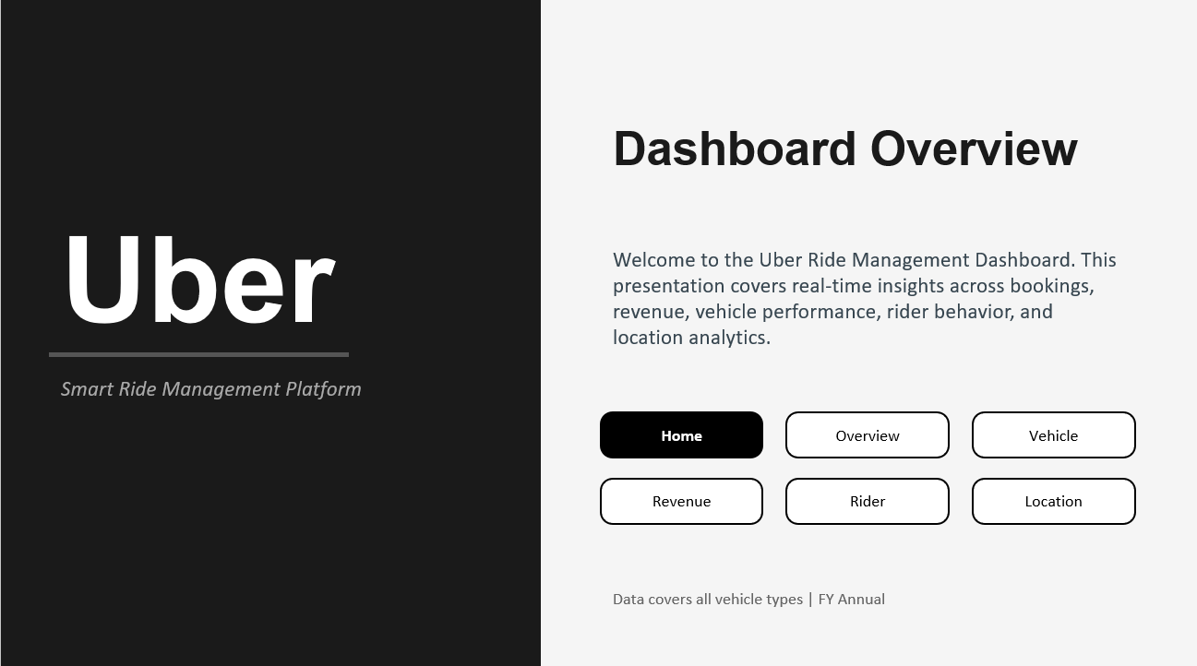
Uber
Dashboard Page 1 — Home
Uber Ride Analytics Dashboard

Slide 14
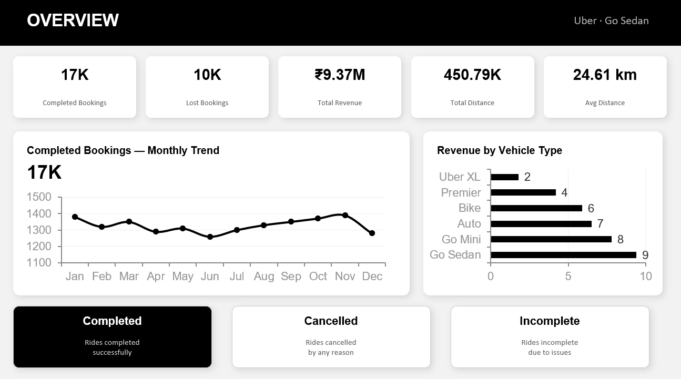

Slide 15
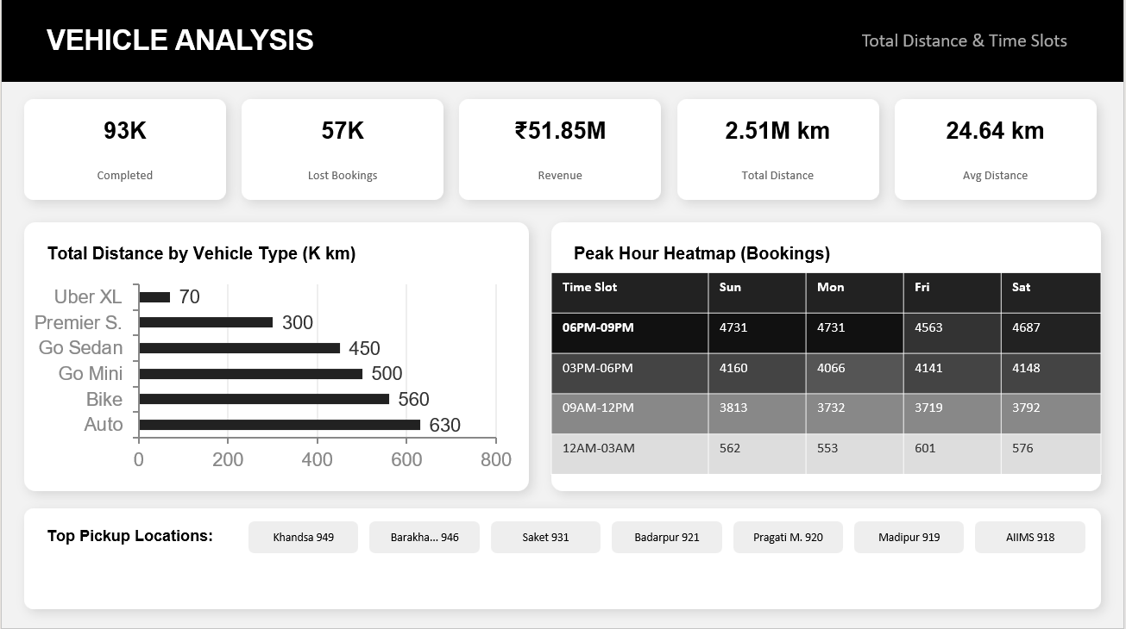

Slide 16
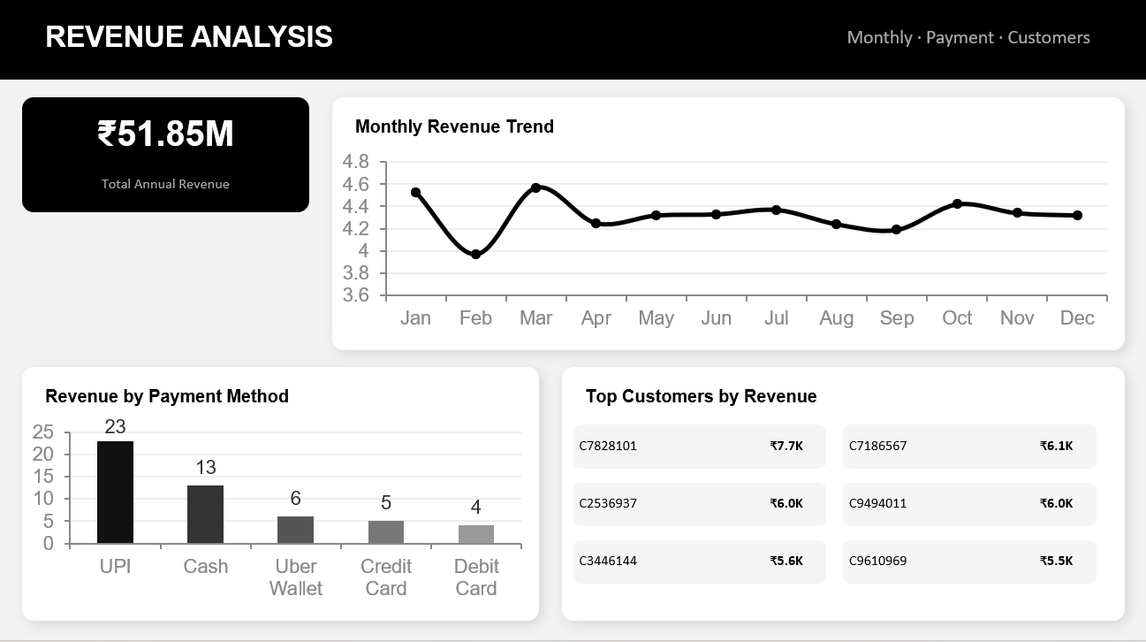

Slide 17
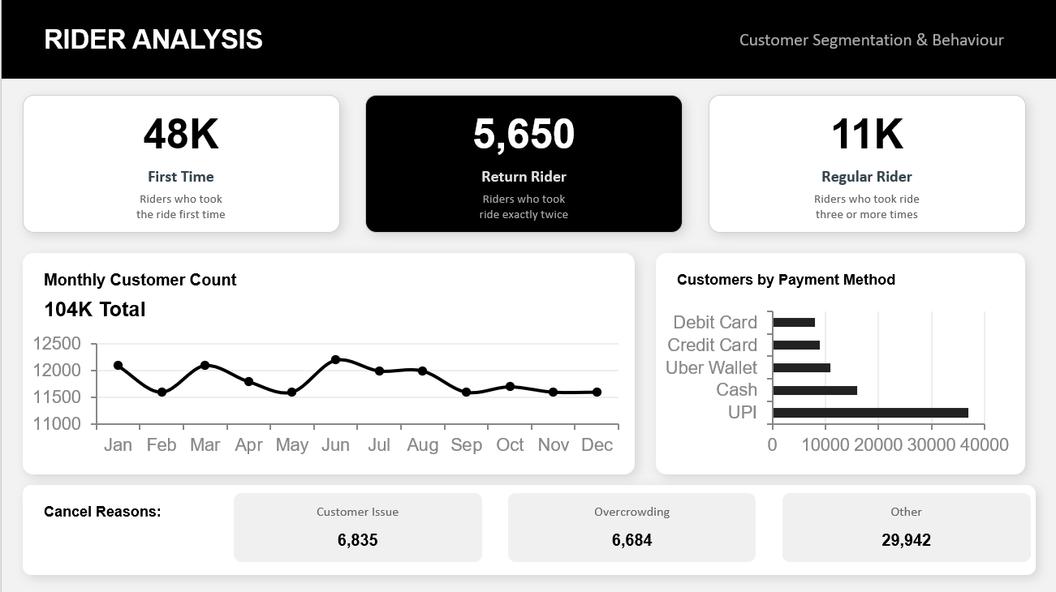

Slide 18
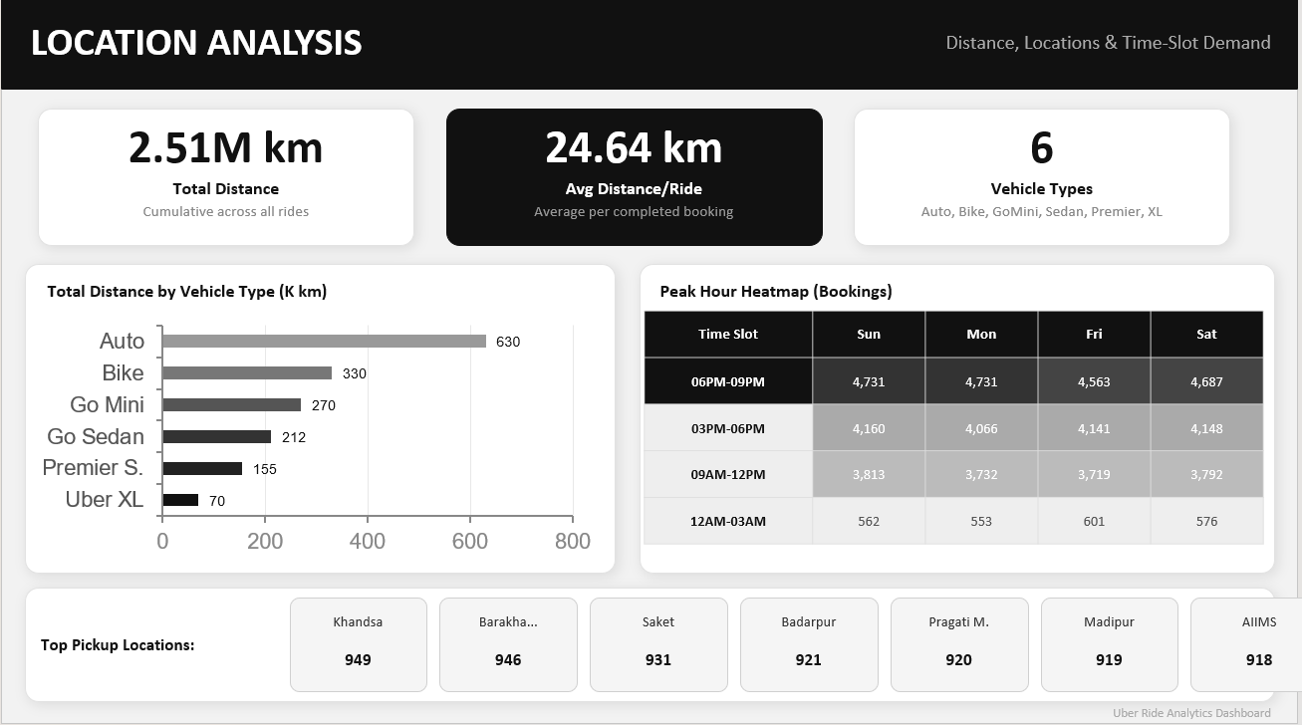

Slide 19
KEY INSIGHTS
01
Auto Leads Volume
02
Peak Hour: 6-9 PM
Auto is the top vehicle with 32,948 customers & ₹1.28Cr revenue. Go Mini follows closely.
The busiest slot across all days with 4,700+ rides. Thursday–Saturday sees highest demand.
03
UPI Dominates
04
Regular Riders = Value
₹23M+ collected via UPI — 44% of all payments. Cash at ₹13M is second.
11K regular riders & 5,650 return riders drive loyalty. 48K first-timers show acquisition strength.
05
Khandsa Top Pickup
06
Feb Revenue Dip
Khandsa (949), Barakha... (946) and Saket (931) are prime pickup zones.
February showed a dip to ₹3.97M and lowest distance at 90K — seasonal pattern to watch.
Uber Dashboard · FY Annual Report

Slide 20
Uber
Dashboard Page 2 — Overview
High-level metrics for all vehicle types combined
93K
57K
₹51.85M
2.51M
24.64
Completed Bookings
Lost Bookings
Revenue
Total Distance
Avg Distance
Vehicle Comparison Table
Key Insights
Vehicle | Customers | Revenue (₹) | Completed
Auto | 32,948 | 1,28,78,422 | 23,128
Bike | 29,138 | 1,14,56,182 | 20,560
Go Mini | 28,358 | 1,03,38,496 | 18,529
Go Sedan | 23,330 | 93,69,719 | 16,666
Premier S. | 16,827 | 62,75,332 | 11,247
Uber XL | 4,447 | 15,28,032 | 2,783
• Auto has highest customers (32,948) and revenue
• Uber XL has fewest customers — niche segment
• Total customers across all types: 1,04,114
• Average ratings: Customer 4.41 ★ | Driver 4.23 ★
• Top pickup: Narsinghpur (126) | Top drop: Ashram (117)
Uber Ride Analytics Dashboard

Slide 21
Uber
Dashboard Page 3 — Vehicle
Drill-down by vehicle type with month/quarter filters
Vehicle Types Covered in Dashboard
Auto
Bike
Go Mini
Go Sedan
Premier Sedan
Uber XL
Booking Trend (Line Chart)
Revenue Bar Chart
Monthly completed booking trend for selected vehicle over 12 months with Month/Quarter toggle.
Monthly/quarterly revenue for the selected vehicle type — compare seasonal peaks and dips.
Donut Charts
Revenue by Vehicle (Bar)
Visual breakdown of Completed, Cancelled, and Incomplete ride percentages per vehicle.
Side-by-side bar chart comparing total revenue across all vehicle types.
Top Pickup & Drop Locations
Ratings Display
KPI cards showing highest volume pickup and drop-off locations for that vehicle.
Average customer and driver rating shown as star ratings for selected vehicle.
Uber Ride Analytics Dashboard

Slide 22
Uber
Dashboard Page 4 — Revenue
Deep dive into revenue by time, vehicle, and payment method
Monthly & Quarterly Revenue
₹51.85M total revenue tracked across 12 months. Peak: Jan (4.53M), Dip: Feb (3.97M). Toggle between Month and Quarter view.
Revenue by Vehicle Type
Horizontal bar chart: Auto leads at ₹13M, followed by Bike ₹11M, Go Mini ₹10M, Go Sedan ₹9M, Premier ₹6M, Uber XL ₹2M.
Revenue by Payment Method
UPI dominates at ₹23M (44%), Cash ₹13M, Uber Wallet ₹6M, Credit Card ₹5M, Debit Card ₹4M.
Revenue by Top Customers
Top customer C7828101 generated ₹7.7K. Top 7 customers all contributed ₹5K+ each to total revenue.
Payment Split: UPI 44% | Cash 25% | Uber Wallet 12% | Credit Card 10% | Debit Card 8%
Uber Ride Analytics Dashboard

Slide 23
Uber
Dashboard Page 5 — Rider
Customer analysis — rider types, payment behavior, and cancellations
48K
5,650
11K
First Time Riders
Return Riders
Regular Riders
Customers who took a ride for the first time
Customers who took exactly two rides
Customers with 3 or more rides
Customer Payment Behavior
Cancel Ride Reasons
Payment Method | Customers
UPI | 37K
Cash | 16K
Uber Wallet | 11K
Credit Card | 9K
Debit Card | 8K
Customer Related Issue
6,835 bookings
More than Permitted People
6,684 bookings
Other Reasons
29,942 bookings
Uber Ride Analytics Dashboard

Slide 24
Uber
Dashboard Page 6 — Location
Distance, location, and time-slot demand patterns
Total Distance by Month
Vehicle by Distance
Peak: Jan (222K km), Dip: Feb (90K km). Monthly trend visible with Month/Quarter toggle.
Auto covers most distance (0.63M km), Uber XL least (0.07M km) — reflects booking volume.
Time Slot Heatmap
Top Pickup Locations
Day vs. Time grid shows 06 PM–09 PM is highest demand slot (max 4,798 rides on Tuesday).
Khandsa (949), Barakha (946), Saket (931), Badarpur (921) — busiest pickup areas.
Uber Ride Analytics Dashboard

Slide 25
Results & Insights
What the data reveals about Uber ride operations
Uber Ride Analytics Dashboard

Slide 26
Uber
Key Findings from Dashboard
Top insights derived from the Uber ride dataset
Booking Volume
Auto dominates with 32,948 customers — highest across all vehicle types. Uber XL is the least used at 4,447 customers.
Revenue Insight
Total revenue is ₹51.85M. Auto generates the most at ₹13M, while Uber XL generates the least at ₹2M.
Payment Trends
UPI is the preferred payment method (₹23M / 44%), followed by Cash (₹13M). Digital payments account for 56% of revenue.
Rider Segments
48K first-time riders vs. 11K regular riders — significant retention opportunity for the business.
Peak Hours
06 PM–09 PM is the highest demand time slot, especially on weekdays. 12 AM–03 AM is the lowest.
Top Locations
Khandsa, Barakha, and Saket are the highest pickup zones — potential for driver deployment optimization.
Uber Ride Analytics Dashboard

Slide 27
Uber
Revenue by Vehicle Type
Visual comparison of revenue across all 6 vehicle types
Revenue Summary
Total Revenue
₹51.85M
Auto (Top)
₹12.88M (25%)
Uber XL (Last)
₹1.53M (3%)
UPI Revenue
₹23M (44%)
Monthly Peak
Jan ₹4.53M
Monthly Low
Feb ₹3.97M
Uber Ride Analytics Dashboard

Slide 28
Uber
Monthly Booking Trend
Completed bookings trend across all 12 months
Insight: Bookings remain relatively stable (7,500–8,200/month). January is the peak month for completed rides.
Uber Ride Analytics Dashboard

Slide 29
Uber
Testing & Validation
How the dashboard outputs were verified for accuracy
Test Case | What Was Tested | Expected Result | Status
KPI Cards | Total Completed Bookings count | 93K (sum of all completed rides) | ✓ Pass
Revenue Total | Total booking value sum | ₹51.85M from dataset | ✓ Pass
Vehicle Filter | Clicking Auto/Bike/etc. filters all visuals | All charts update to selected vehicle | ✓ Pass
Month Toggle | Month vs. Quarter button switch | Charts switch between month and quarter view | ✓ Pass
Navigation | Page buttons on Home/each page | Correct page loads on button click | ✓ Pass
Donut Charts | Completed/Cancelled/Incomplete % | Values match dataset status counts | ✓ Pass
Heatmap | Time slot × weekday demand grid | Peak: 06–09 PM, correct day mapping | ✓ Pass
Ratings | Avg customer and driver ratings | 4.41 and 4.23 confirmed by AVG DAX | ✓ Pass
Uber Ride Analytics Dashboard

Slide 30
Uber
Future Scope & Improvements
Features and enhancements that can be added to the project
01
Live Data Integration
02
Predictive Analytics
Connect Power BI to a live database or API (e.g., Azure SQL, Uber API) for real-time dashboard updates without manual refresh.
Use Python or R integration within Power BI to add ML models for ride demand forecasting and driver allocation.
03
Driver Performance Module
04
Customer Segmentation
Add a dedicated page tracking individual driver ratings, completion rate, earnings, and cancellation frequency.
Implement RFM (Recency, Frequency, Monetary) analysis to better segment riders and design loyalty programs.
05
Mobile Dashboard
06
City-Level Drilldown
Publish dashboard to Power BI Mobile for on-the-go access by operations managers and executives.
Expand location analysis from area-level to city-level with interactive map visuals using Bing Maps in Power BI.
Uber Ride Analytics Dashboard

Slide 31
Conclusion
▸ The Uber Ride Analytics Dashboard was successfully developed using Microsoft Power BI.
▸ The dashboard covers 6 pages: Home, Overview, Vehicle, Revenue, Rider, and Location.
▸ ~1.5 Lakh ride records were cleaned, modeled, and visualized with 19 data columns.
▸ Key KPIs including Revenue (₹51.85M), Completed Bookings (93K), and Average Distance (24.64 km) are accurately computed.
▸ The project demonstrates real-world application of data analysis, DAX, and Power BI in a business context.
Thank You
Rajat Bareja | Data Analyst | Power BI · SQL · Python
github.com/RajatBareja | linkedin.com/in/rajat-bareja-b98269394

